Slide 1
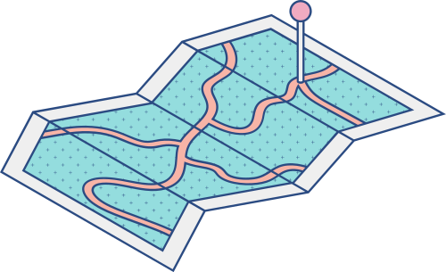





MeetMate
An easy to use cloud web application for your online meeting needs.
Ankit Juneja
Aryan Jindal
Divyam Agrawal (L)
Anand Kataria
Aayush Singh Panwar

Slide 2
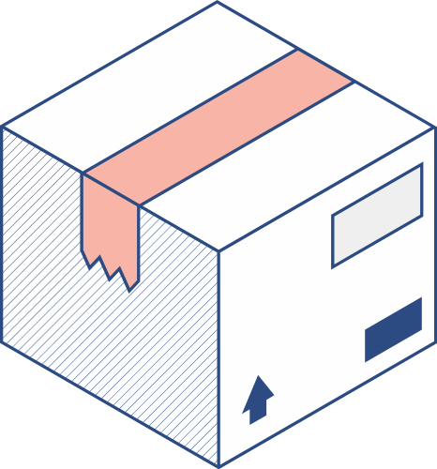


Traditional Online Meets
Online Meets with MeetMate
Troublesome Note Making
Less Motivation
Low Attentiveness
Clutter of of large minutes of meeting
Meeting recording on the mercy of the host
Smooth Note making process
Live Attentiveness Tracking
Complete Speech to text
Fast Screenshot
Quick Screen Recording
Class Status Warning
Full PDF Generation

Slide 3
Features of MeetMate
PDF Generation
16.7%
Attentiveness Tracking
22.2%
Class Status Warning
13.9%
We tried our best to make MeetMate practical, feature rich, user friendly and also something eye pleasing!
Speech To Text
22.2%
Screenshot
11.1%
Screen Recording
13.9%

Slide 4
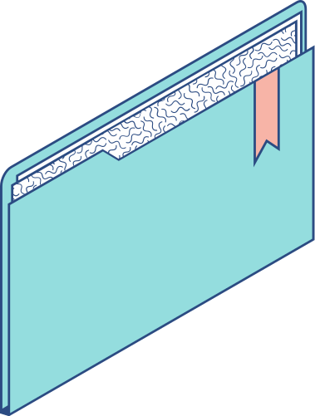
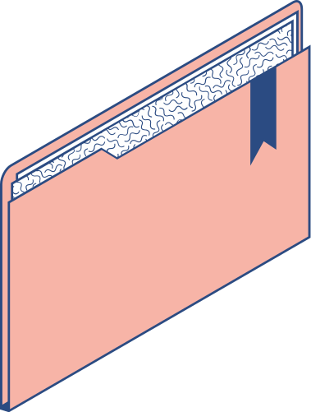
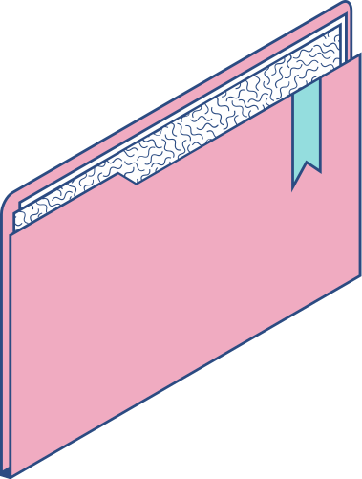
2
Feature:
Attentiveness Tracking
1.5
1
0.5
0
As we all know that sometimes we get distracted on small notice. So a basic solution to this problem is that if we get warning when ever our attention is low towards our screen, or when ever we are given a score corresponding to our attention span which will motivate user for paying attention.

Slide 5

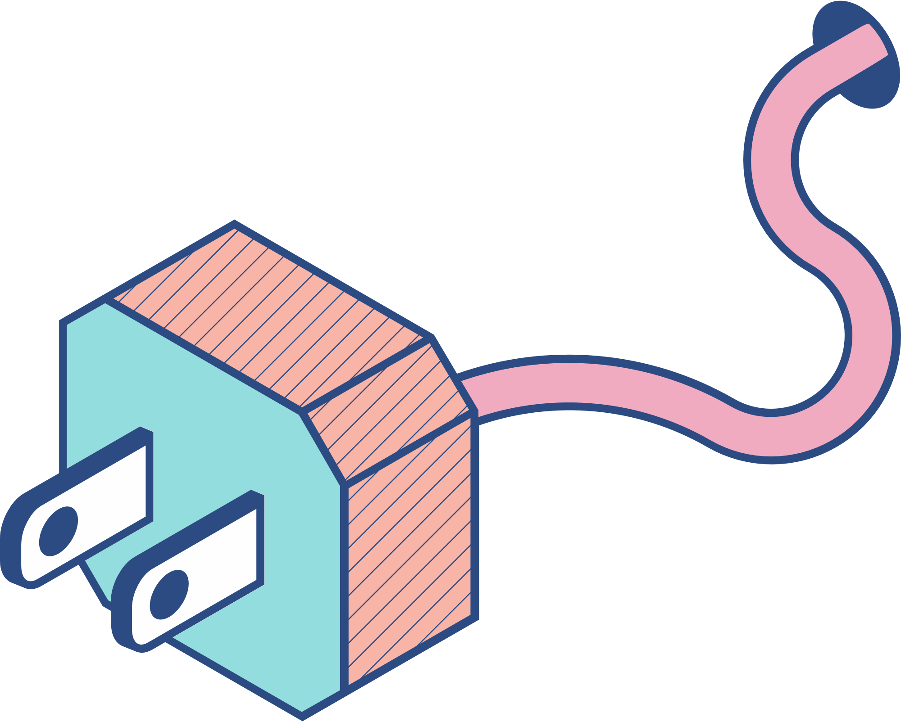
IMPLEMENTATION
As soon as the user starts using MeetMate , the attentiveness tracking starts and produces a attScore at every two seconds according to criteria shown in our README and the attention status and attentive score is displayed to the user with a live plot of attentiveness vs time. A beep is produced when the attentiveness is too low.

Slide 6

As soon as MeetMate starts, webgazer.js is initiated to predict eye location on the screen and return the x & y coordinates. Then after each two seconds , we generate attentiveness score and status by following the criteria shown in our README through x & y coordinates and a beep sound at low attentiveness. We also generate a cumulative attentiveness score in form of percentage.
Storing all the previous scores and time stamps that generate after every two seconds in two different arrays, we plot a live attentiveness vs time graph.

Slide 7
Feature: Speech-to-Text
Sometimes the things that the host explains is more understandable than what the lecture notes/minutes of meetings provide.
Sometimes due to forced inattentiveness during online meets we tend to miss the crucial moments in the meet.

Slide 8
IMPLEMENTATION
When the user clicks speech-to-text Off button, the recognition starts and the user can see the speech-to-text results in the lower section of MeetMate. The program analyses each new increment in recognition result and generates a speech score to alert the user according to its value.
The user has the choice to switch off speech recognition anytime he/she wants, it also alerts the user when the recognition stops due to prolonged inactivity.

Slide 9

After clicking sp2txt button the recognition starts and the webkitSpeechRecognition API is fetched and is made continuous.
We tokenize the last sentence and analyze those tokens through a dataset and generate a speech score by adding the values of charted words. If the speech score is positive then 'All good' is notified to the user else user is notified with a 'Warning' and three small beeps.
Incase the sp2txt stops itself then we warn the user with two beeps and a window alert.

Slide 10

Feature :
Screen Recording
The ability to record the session is a very handful feature.
This ensures that you only record the most important moments and get rid of all mundane stuff.
The ability to record multiple videos is also very benifitial.

Slide 11
IMPLEMENTATION
When the user clicks the RECORD button, he/she gets the option to select which window he/she wants to record.
The user can stop the recording whenever he/she wants and is able to download the video by clicking the download button.
MP4 format video is then downloaded in the user's local storage.

Slide 12
We initialize some variables that account to URL creation, setting screen and audio recording and storing video data. When the record button is clicked, we fetch the screen media source and audio of the user and consolidate both in a single variable and start the recording and then the recording data is stored and when stop recording button is clicked the recorder stops and a URL to MP4 video data is created.
When the user clicks the download button, the URL is injected and a video file is downloaded in the user's local storage.

Slide 13

Feature:
Screenshot and PDF generation
The feature that helps us to quickly grab the screenshot of any window the user likes, whenever the user wants to, would prove to be very useful during any online meet.
The availability of PDF generation feature that contains both speech-to-text results and screenshots would prove to be a very handy resource during any online meet.

Slide 14
IMPLEMENTATION
When the user clicks the Screenshot button, he/she gets the option to choose the window that she/he wants to take the screenshot of and then the screenshot is drawn with a timestamp in the MeetMate panel.
When the user clicks the "Download PDF" button, a PDF with the clicked screenshots and speech to text results is generated with a timestamp and is downloaded in the user's local storage.

Slide 15
When user clicks the Screenshot button, a stream is generated to record the screen and access the first element of the video i.e. image. And then creates a map of the image and stops the recording. A canvas element is appended in the Screenshot area and the screenshot is drawn with a timestamp appended with it.
When the user clicks "Download PDF" button, 'html2pdf.js' API is used to get contents from 'pdfDiv' division and saves the pdf in the user's local storage.

Slide 16

How MeetMate can change your professional lives
More Attentiveness
Meeting Summary
By monitoring your attentiveness during your meet, we tend to increase your attentive ness, and by showing you attentiveness percentage, we motivate the user to perform better
Class Status
By the ability to record screen, taking screenshot and complete speech to text of the meet, and PDF generation the user has all the variety of features for great meeting experience
With continuous monitoring of your speech to text results, we would notify you whenver the status of the class is not good.

Slide 17
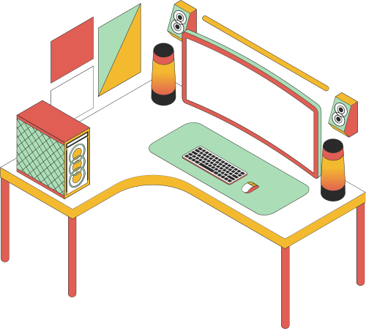
How MeetMate can change your Workspace?
More focus on attentiveness
Now the company knows who pays how much attention during their worktime and by giving incentives based on Attentive Score, the productivity of the office can be increased!
Also by studying attentiveness pattern, mental health professionals can help anyone facing attention issues!

Slide 18

How MeetMate can change your Workspace?
More focus on clarity
Sometimes miscommunication can lead to wrong decisions and this is where MeetMate comes in, equipped with useful technologies makes sure that you are always clear about everything.
This would help in increasing efficiency of various organizations and decision making would be accurate!

Slide 19
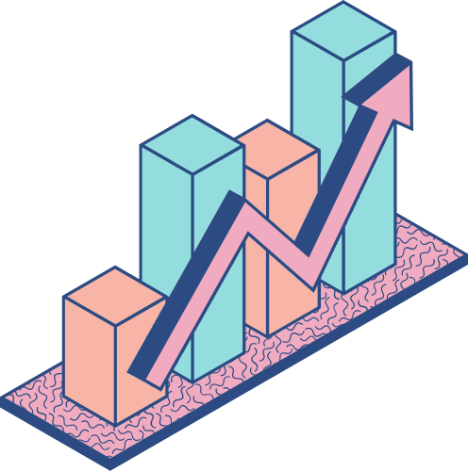
MeetMate surely
helps you in your
professional
progress!

Slide 20


Final Words
A Great Opportunity
A Great Mentor
A Great Team
A Great Learning
A Great Project

